Slide 1
Not Just a Black Box: Interpretable Deep Learning
CS 273B / Oct 5 2016 / Avanti Shrikumar

Slide 2
In this talk
Compute importance scores for individual inputs in a deep learning model
Discover patterns by summarizing importance scores

Slide 3
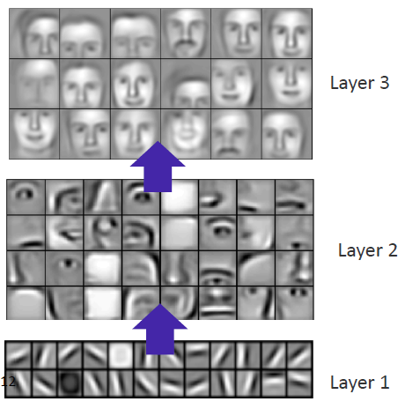

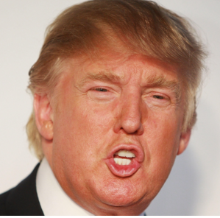
Deep neural networks (DNNs) for image classification
Output label: Trump? Or Sanders?
…
…
…
…
Input: image pixel values
Lee et. al. (2009), ICML

Slide 4
Compute importance scores

Slide 5
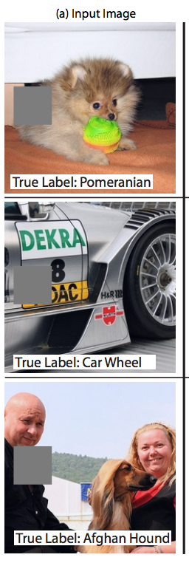
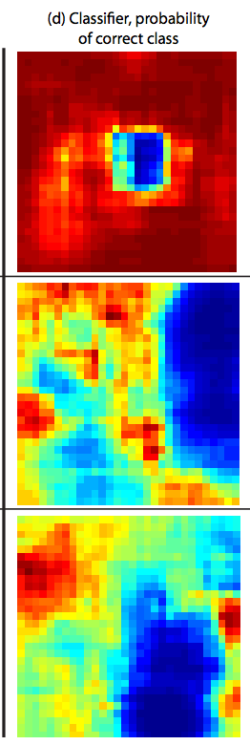


How can we compute importance scores?
Idea 1: perturbation
Output label: Trump? Or Sanders?
…
…
…
…
Input: image pixel values
https://arxiv.org/pdf/1311.2901v3.pdf
“In-silico mutagenesis” in the context of DNA sequence

Slide 6
Drawbacks of perturbation
Computational efficiency
Requires one forward propagation for each perturbation
Saturation

Slide 7
Saturation problem illustrated
y = (i₁ + i₂) when (i₁ + i₂) < 1
= 1 when (i₁ + i₂) >= 1
y = 1 - h
=1
h
1
y
h =
max(0, 1 – i₁ – i₂)
0
1
2
i₁ + i₂
i₁
i₂
=1
=1
0

Slide 8
How can we compute importance scores?
Idea 2: backpropagate importance
Output label: Trump? Or Sanders?
…
…
…
…
Input: image pixel values

Slide 9
Idea 1: deconvolutional nets
Originally applied as unsupervised learning:
http://www.matthewzeiler.com/pubs/cvpr2010/cvpr2010.pdf
Adapted for visualization
Forward pass
(bias=0 for all
conv neurons)
Deconv
max
1
“switch” to correct max
1
relu
0
1
0
1
relu
-2
1
0
1
conv
1
1
1
-1
“deconv”
1
1
1
-1
-1
2
-1
2
0
0
1
1
0
1
2
-1
relu
(max(x,0))
relu
-2
-3
1
1
0
1
2
0
“deconv”
conv
-2
2
1
-2
-1
3
-3
4
1
-2
-1
3
-3
4
-2
2
2
1
2
1
1
0
1
-4
6
0

Slide 10
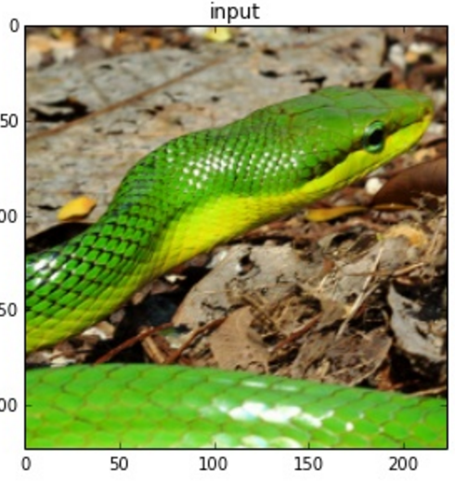
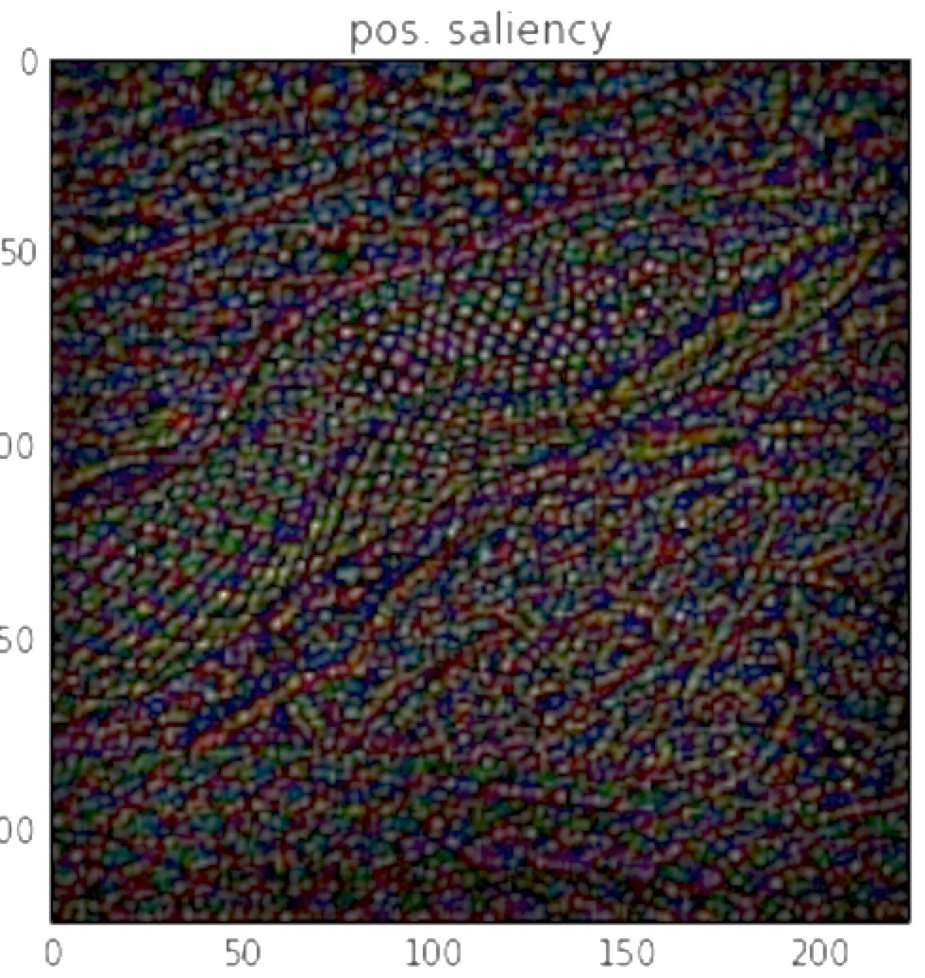
Deconv net: example

Slide 11
Idea 2: Gradients
First proposed by Simonyan et al. Used to improve image segmentation.
Equivalent to deconv nets, except in handling of ReLUs

Slide 12
max
1
Forward pass
relu
0
1
-2
1
conv
1
-1
1
1
2
-1
relu
0
0
1
1
-2
-3
1
1
conv
-2
2
1
-2
-1
3
-3
4
2
1
2
1
1
1
Deconv
Gradient of output w.r.t. itself=1
1
Gradients
“switch” to correct max
0
1
0
1
0
1
relu
0
1
0
1
0
1
“deconv”
1
1
1
-1
1
-1
1
1
2
-1
-1
2
0
1
2
-1
0
1
2
-1
relu
0
0
1
1
“deconv”
0
1
2
0
0
0
2
-1
-2
2
1
-2
-1
3
-3
4
-2
2
-1
2
-1
3
-3
4
0
1
-4
6
0
0
0
-2
9
-4
2
1
2
1
1
grad*inp
0
0
-4
9
-4

Slide 13
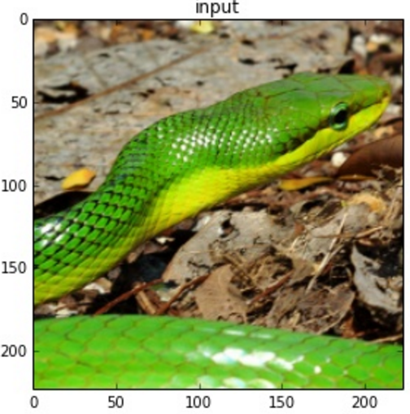
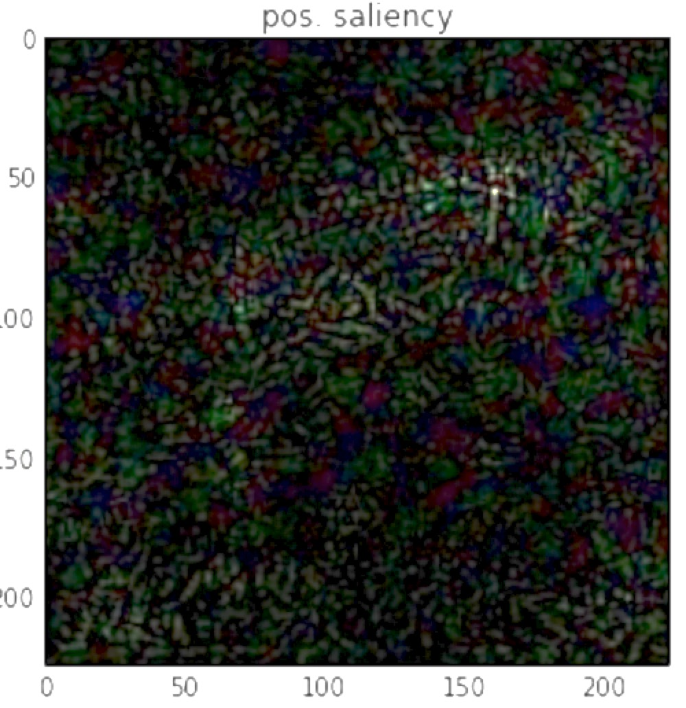
Deconv
Gradients

Slide 14
Idea 3: “Guided backpropagation”
Deconv seems to have some advantages, gradients seems to have some advantages
Just combine the two
When going through ReLUs, zero out gradients when input is < 0 AND when gradient is < 0

Slide 15
max
1
Forward pass
1
Deconv
“switch” to correct max
relu
0
1
0
1
relu
conv
-2
1
0
1
1
-1
1
1
2
-1
“deconv”
1
1
1
2
-1
-1
relu
0
0
1
1
0
1
2
-1
relu
conv
-2
-3
1
1
“deconv”
0
1
2
0
-2
2
1
-2
-1
3
-3
4
-2
2
1
-2
-1
3
-3
4
2
1
2
1
1
0
1
-4
6
0
1
Gradients
1
Guided backprop
0
1
0
1
0
1
0
1
0
1
0
1
0
1
0
1
1
-1
1
1
2
-1
1
1
1
-1
-1
2
0
1
2
-1
0
1
2
-1
0
0
1
1
0
0
1
0
0
0
2
-1
0
0
2
0
-2
2
-1
2
-1
3
-3
4
-2
2
-1
2
-1
3
-3
4
0
0
-2
9
-4
0
0
-2
6
0

Slide 16
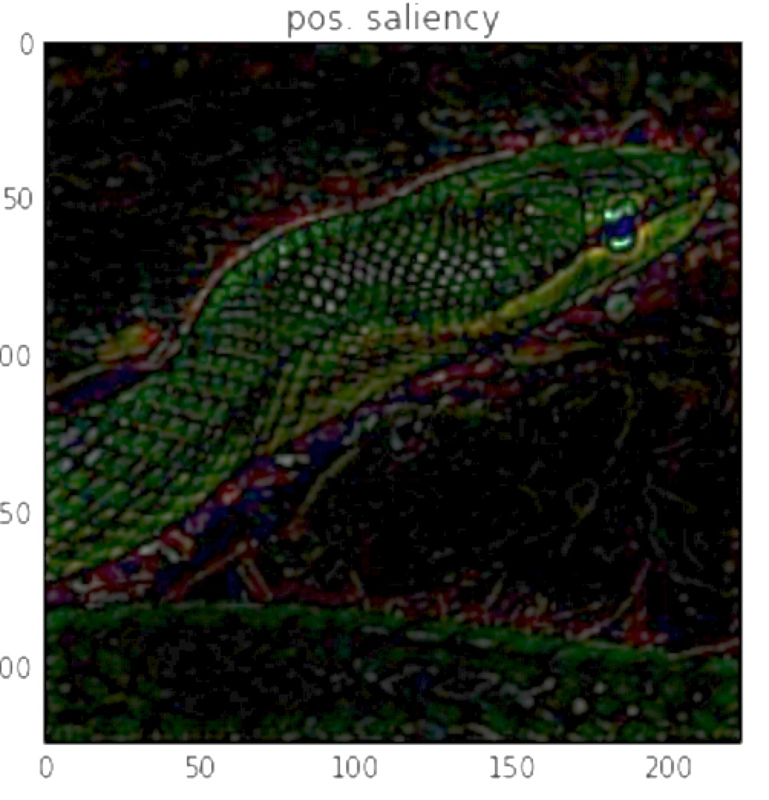
Deconv
Gradients
Guided Backprop

Slide 17
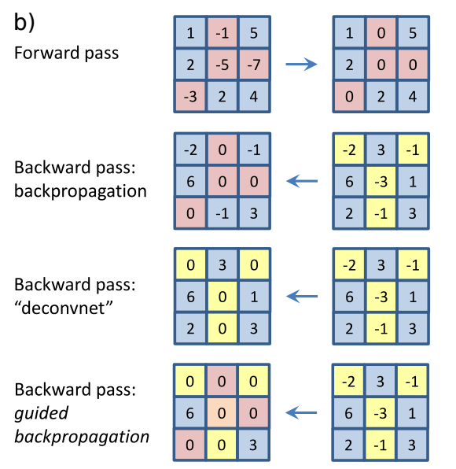
Summary of differences
ReLU(x) = max(0, x)
Forward-pass
ReLU
Red = input < 0
Yellow = gradient < 0
Zero-out gradients
through inactive ReLUs
Gradients
Zero-out negative gradients & ignore ReLU
Deconv
(Combined)
Zero-out inactive ReLUs
Zero-out negative gradients
Guided backprop
No consideration of nonlinearities other than ReLU
No special handling of biases

Slide 18
Example failure-mode: saturation
y = (i₁ + i₂) when (i₁ + i₂) < 1
= 1 when (i₁ + i₂) >= 1
When (i₁ + i₂) >= 1,
gradient is 0
y = 1 - h
h
1
Negative gradients do not pass through ReLU for deconv and guided backprop
y
h =
max(0, 1 – i₁ – i₂)
0
1
2
i₁ + i₂
i₁
i₂

Slide 19
Idea 4: DeepLIFT
Moves away from gradients, relying on “difference from reference”
Solves saturation problem and other problems
Equivalent to gradient*input when biases in the network are all zero

Slide 20
The DeepLIFT solution: difference from reference
y = (i₁ + i₂) when (i₁ + i₂) < 1
= 1 when (i₁ + i₂) >= 1
Reference: i₁=0 & i₂=0
y = 1 - h₁
h=1 when (i₁ + i₂) = 0 (reference)
h
1
At (i₁ + i₂) = 2, the “difference from reference” is -1, NOT 0
h₁ =
max(0, 1 – i₁ – i₂)
0
1
2
i₁ + i₂
i₁
i₂

Slide 21
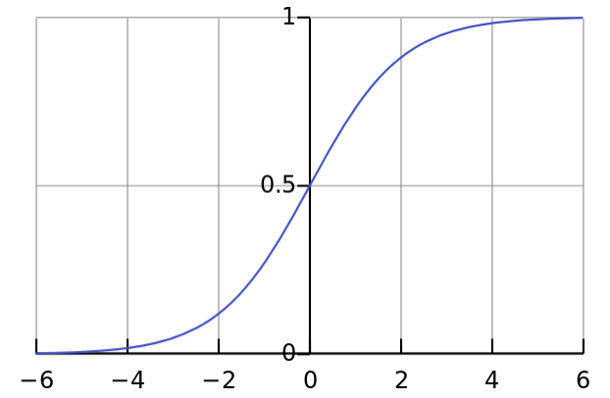
DeepLIFT generalizes to all activations
“difference from reference” is +0.5 when inputs is >> 0
(assuming reference input of 0)
Sigmoid is 0.5
when input is 0

Slide 22
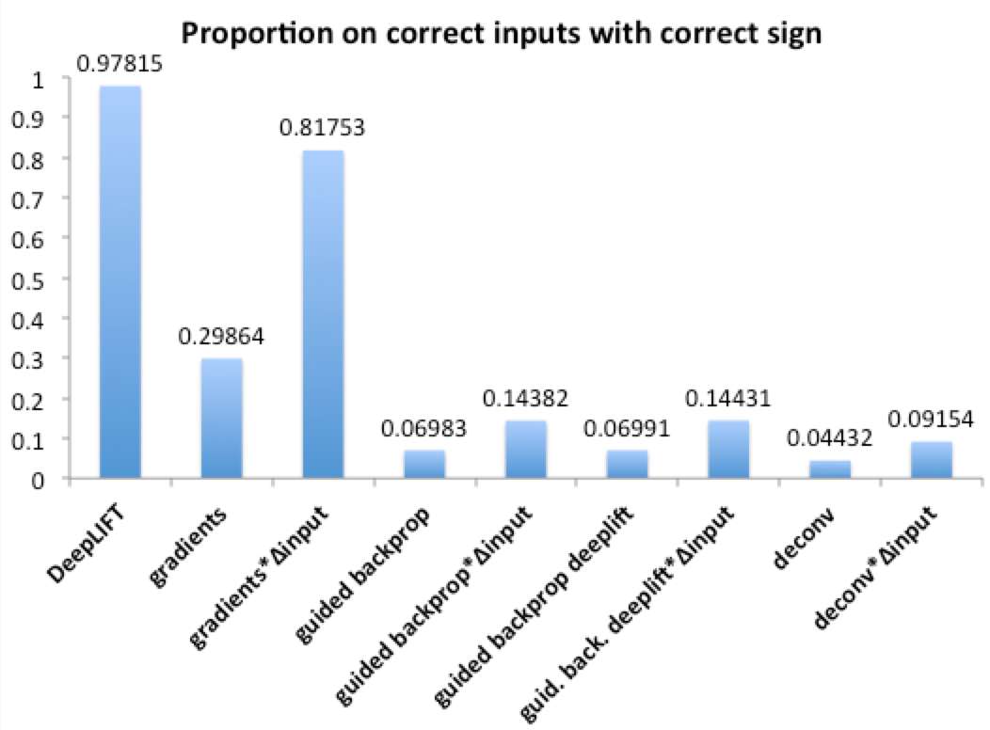
Saturation simulation
50 inputs: uniformly sampled from -0.5 to 0.5
10 “rules”: Each rule fires if an exclusive set of 5 inputs has a sum > 0.
10-choose-2: 45 outputs, each corresponding to a pair of rules. The label is 1 if both rules in the pair fire, and 0 otherwise
For a given output, what proportion of total importance over all inputs is attributed to the correct 10 inputs with correct sign?
y₁₂ = sigmoid(1 – h₁ – h₂)
h₁ = max(0, -(i₁+…+i₅))
h₂ = max(0, -(i₆+…+i₁₀))
i₁
…
i₅
i₆
…
i₁₀
Notes:
"bestValidPerf": 0.996026666667,
"totalEpochsSeen": 134,
"bestTrainPerfEpoch": 130.0,
"modelCreationClass": "DnnSequentialModelCreator",
"modelCreationClassArgumentsString": {
"finalLayerActivation": "sigmoid",
"numOutputs": 45,
"optimizerType": "adam",
"fcLayers_sizes": [
20
],
"seed": 1234,
"numInputs": 50
},
"additionalDescription": "",
"batchSize": 200,

Slide 23
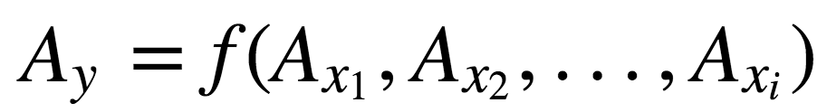
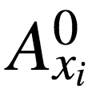
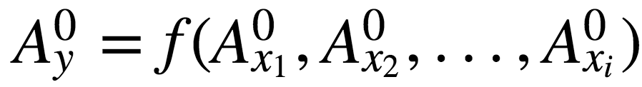
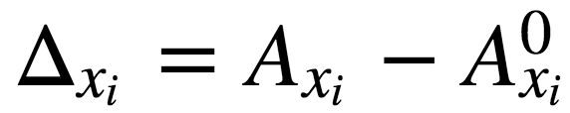
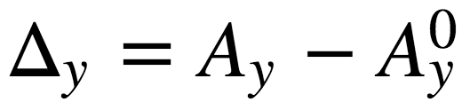
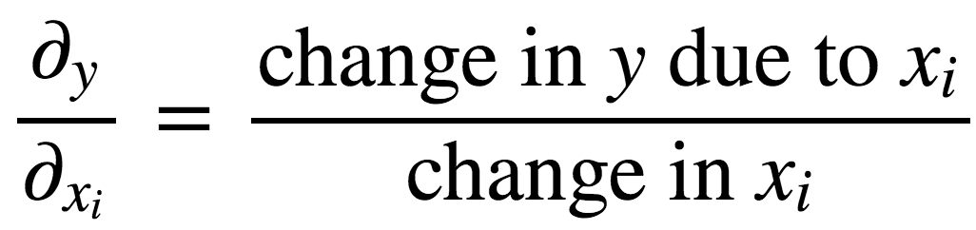
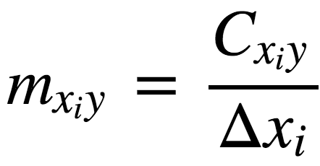
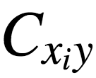
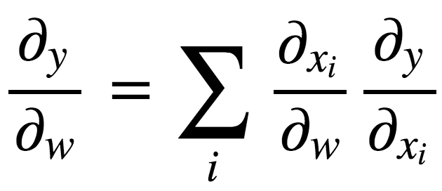
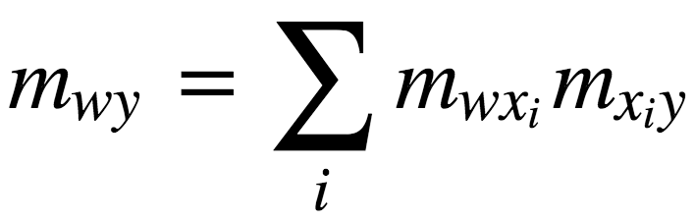
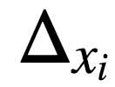
“Multipliers”: alternative to gradients
Let
represent the “reference” activation of x_{i}
Partial derivatives
DeepLIFT multipliers
is the portion of
attributed to
(chain rule)

Slide 24
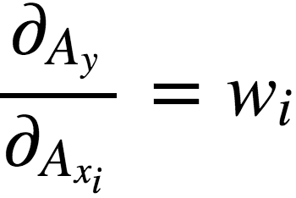
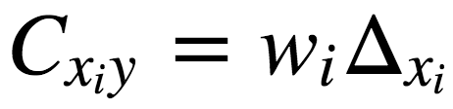
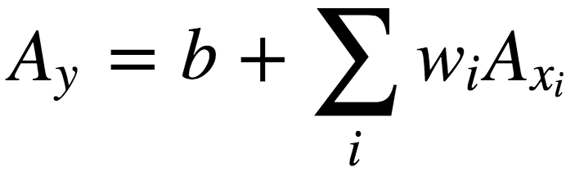
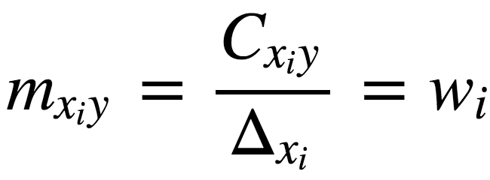
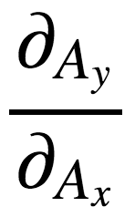
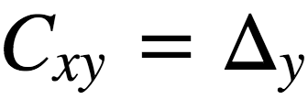
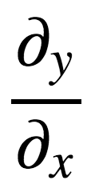
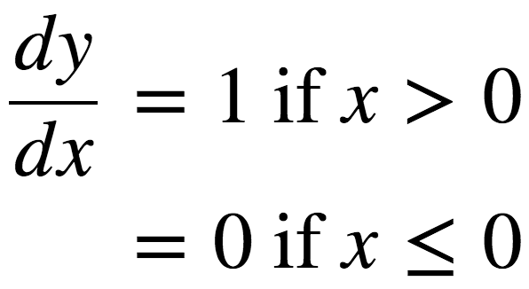
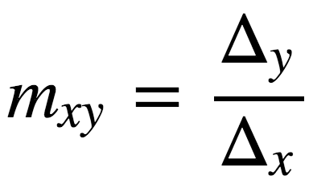
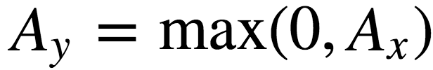
Multiplier definitions
DeepLIFT multiplier
Function
Gradient
Linear
ReLU

Slide 25
Example failure-mode 2: thresholds
3 =
2
+
1
h₁=1
y = 2h₁ + 2h₂
h₂=0.5
1
dy/dh₁ = 2
0.5
dy/dh₂ = 2
1
1.5
2
h₁ = max(0, i₁)
h₂ = max(0, i₂ – 1.5)
dy/di₁ = 2
dy/di₂ = 2
grad*inp = 2
i₁=1
grad*inp = 4
i₂=2
Contributions from i₁ & i₂ are 2 and 1 respectively,
but gradient*Δinput is 2 and 4 respectively

Slide 26
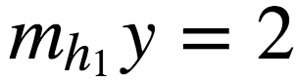
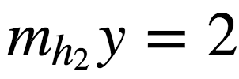
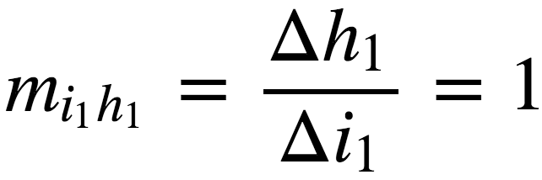
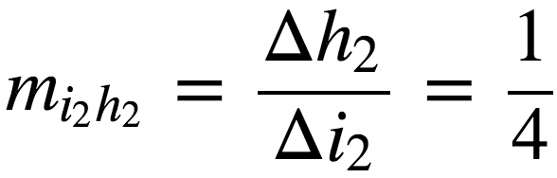
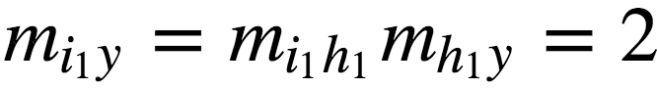
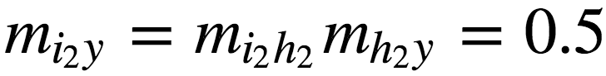
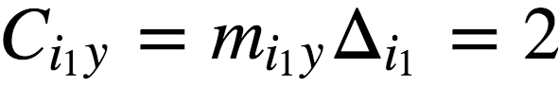
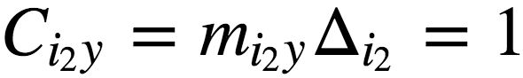
Solution with DeepLIFT
3 =
2
+
1
h₁
ref = 0
h₂
y = 2h₁ + 2h₂
Δy = 3
1
0.5
1
1.5
2
ref = 0
h₁ = max(0, i₁)
h₂ = max(0, i₂ – 1.5)
ref = 0
Δh₁ = 1
Δh₂ = 0.5
i₁=1
i₂=2
ref = 0
ref = 0
Δi₁ = 1
Δi₂ = 2
Notes:
m_{i_1y} = m_{i_1 h_1} m_{h_1 y} = 2
C_{i_2y} = m_{i_2y}\Delta_{i_2}=1

Slide 27
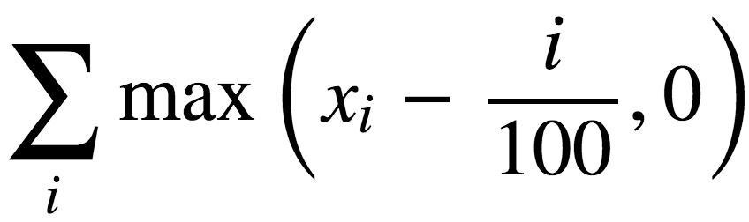
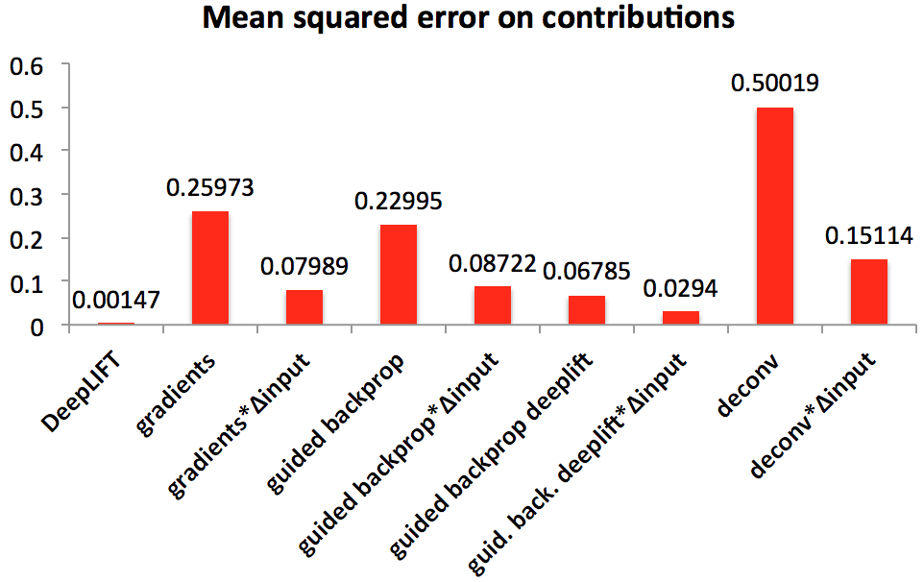
Threshold simulation
100 inputs x_{i}, uniformly sampled from 0 to 1
Output is
y = h₁ + … + h₉₉
h₁ =
max(i₁ – 0, 0)
h₅₀ =
max(i₅₀ –
.50, 0)
h₉₉ =
max(i₉₉ –
.99, 0)
i₁
…….....
i₅₀
…………
i₉₉
Notes:
"bestValidPerf": 0.000314366039102,
"totalEpochsSeen": 448,
"bestTrainPerfEpoch": 438.0,
"modelCreationClass": "DnnSequentialModelCreator",
"modelCreationClassArgumentsString": {
"finalLayerActivation": "linear",
"numOutputs": 1,
"optimizerType": "adam",
"fcLayers_sizes": [
50
],
"seed": 1234,
"numInputs": 20
},
"additionalDescription": "",
"batchSize": 1000,

Slide 28
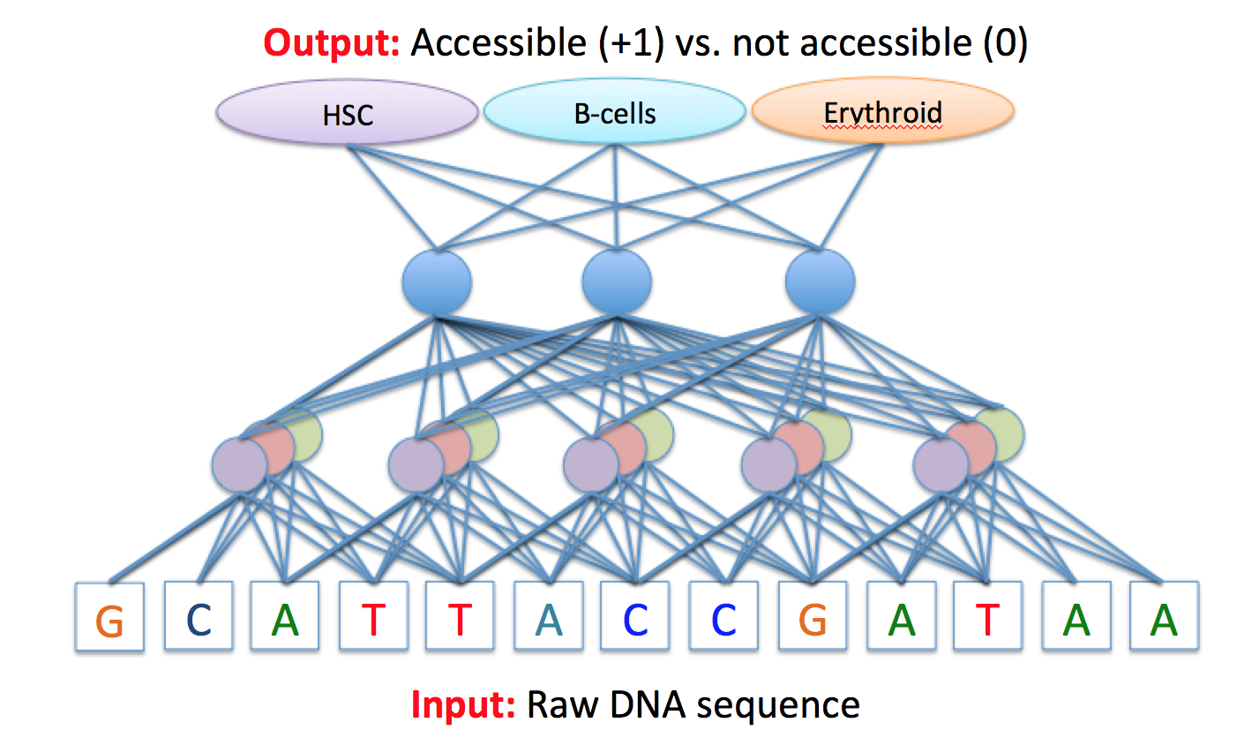
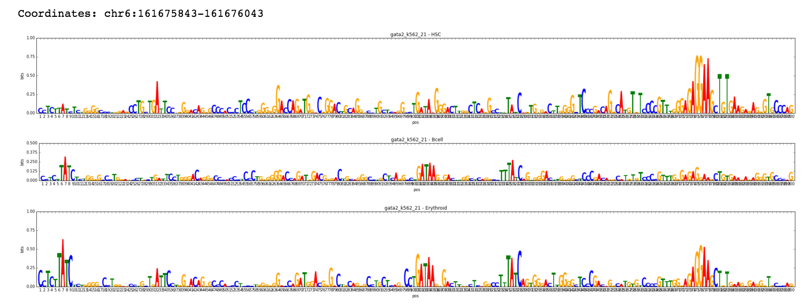
Genomics: DeepLIFT highlights essential DNA bases
Input
Model + DeepLIFT
Output

Slide 29
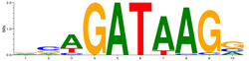
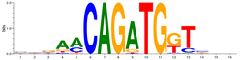
DeepLIFT captures essential features that gradients miss
Simulation: random background sequence with
and/or
Positive set: BOTH
AND
Deconv nets
Guided backprop
Gradients
DeepLIFT

Slide 30
Pattern Discovery

Slide 31
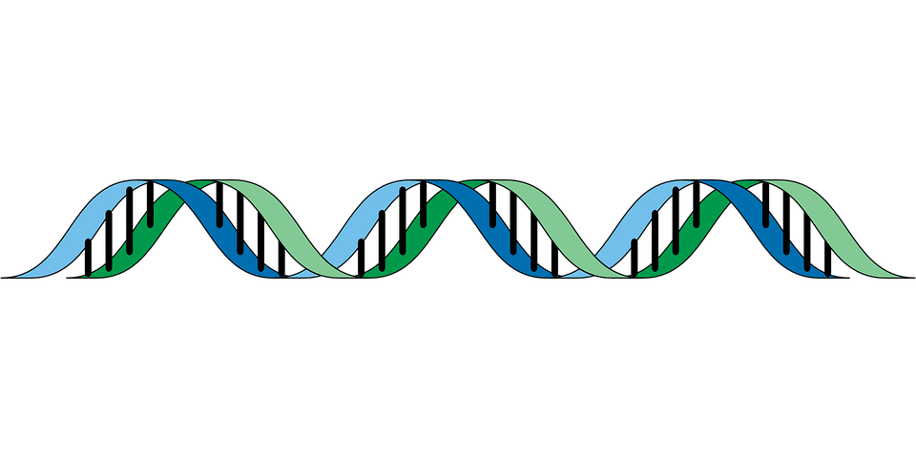
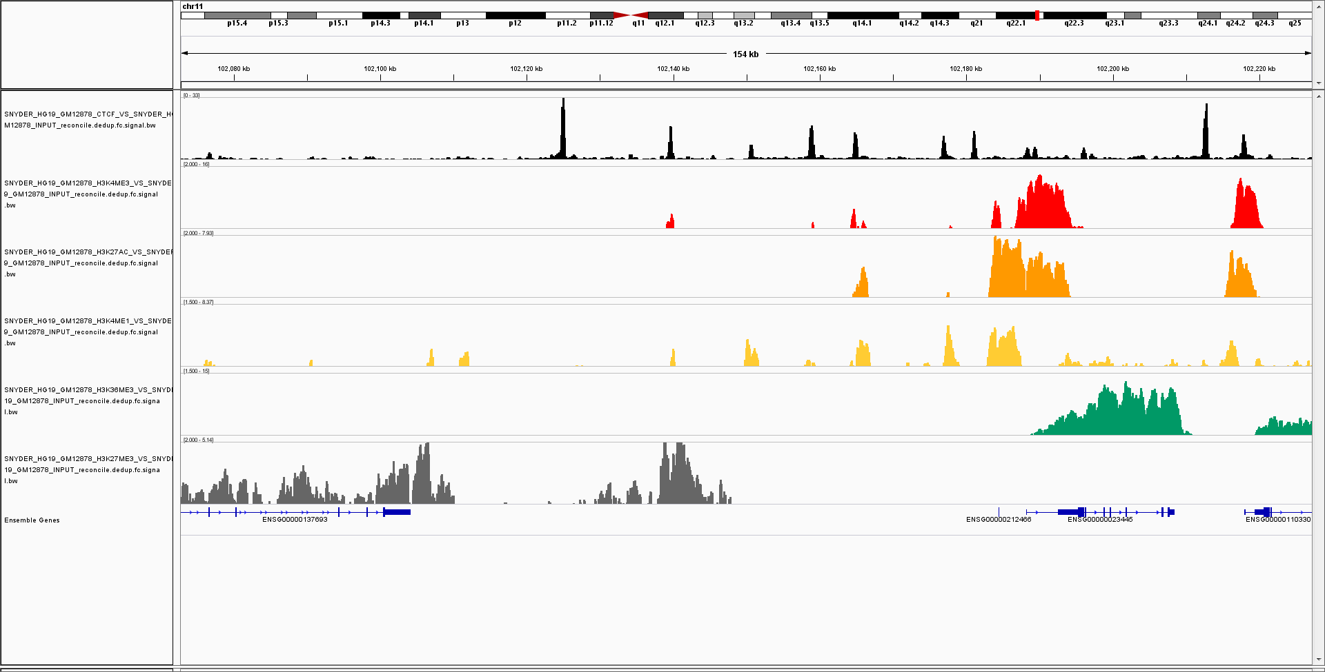
DNA-binding protein
Training data: 1000s of ‘positive examples’ (sequences) bound by protein
vs.
millions of ‘negative examples’ i.e. rest of the genome
Protein-DNA binding signal

Slide 32
Convolutional neural networks to predict binding of proteins to DNA sequence
Output: Bound (+1) vs. not bound (0)
Protein binds?
Convolutional layer
G
C
A
T
T
A
C
C
G
A
T
A
A
Input: Raw DNA sequence, one-hot encoded

Slide 33
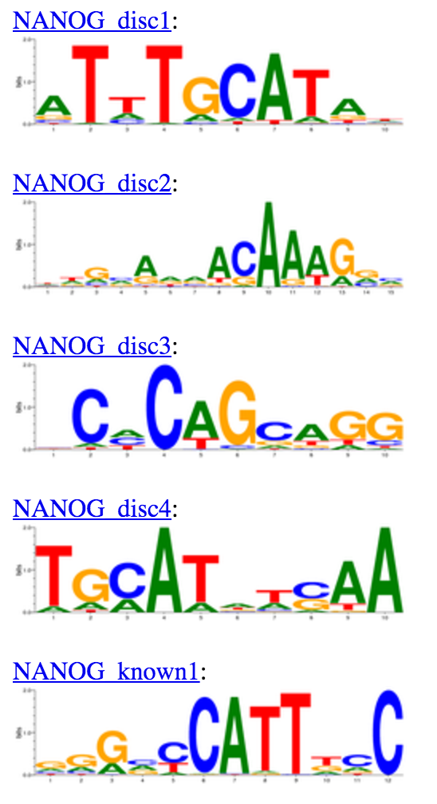




Learning reoccurring patterns
ENCODE PWMs
(Kheradpour et al.)
(Spoiler)
Result of MoDISco

Slide 34

Visualizing individual convolutional neurons gives highly distributed representations
DeepBind (Alipanahi et al.) for Nanog
In computer vision

Slide 35





How do we combine the aggregate contribution of multiple pattern detectors at individual sequences?
Insight: filter contributions are resolved at the input level
Δprob
Sequence 1
Δprob
Sequence 2
Δprob
Sequence 3
MoDISco: Motif Discovery from Importance Scores

Slide 36






MoDISco uncovers broader patterns than existing approaches
MoDISco
Known pattern
(Heinz et al.)
Oct-Sox-Nanog
MoDISco
Known pattern
(Heinz et al.)
Nanog
MoDISco
Known pattern
(Heinz et al.)
Sox2
MoDISco
Zic3 (Jaspar; Zhao et al.)
Known pattern
(Heinz et al.)
“Unknown ESC element”

Slide 37




At least 3 distinct classes of Nanog sites
Zic3 motif
Oct4-Sox2-Nanog fusion motif
Sox2 motif
Nanog motif
1
Reproducible Nanog ChIP-seq peaks
2
3

Slide 38




Potential novel relationship between Nanog and Zic3 discovered
Nanog
Re-cluster with Nanog/Zic3 patterns only
Zic3
Novel combination of Nanog and Zic3 patterns
Notes:
Increase font of axes values in figure
Explicitly label “predominant spacing = 10 bp”

Slide 39



MoDISco patterns outperform traditional motif discovery methods
Logistic regression on top hits to each pattern, auROC
5 known motifs
(ENCODE db)
4 known motifs (HOMER db)
Top 4 de-novo from traditional method (HOMER)
All 32
de-novo from traditional method (HOMER)
4 MoDISco
Motifs discovered on validation set

Slide 40



In development: Discover dependencies with “Delta DeepLIFT”
Simulation: random background sequence with
0-2
0-2
Positive set: at least one
and at least one
Identify sequences with one
and one
Mutate the

Slide 41


Caveats/Limitations
You need a good reference!
Confidence scores
Ideas: test-time dropout, simulations
Original
Taylor
DeepLIFT – flat ref
DeepLIFT – learned ref
Ref =
Activations @ input of all zeros
Ref =
Mean activations (pre nonlinearity)

Slide 42
Summary
Find importance scores:
Perturbation-based methods can find importance scores, but are inefficient and susceptible to saturation
Backpropagation-based methods are efficient
Examples of backpropagation methods include deconv nets, gradients, guided-backpropagation and DeepLIFT
DeepLIFT works by looking at difference-from-reference, which addresses limitations of other methods
However, DeepLIFT relies on having a good reference
Find patterns:
Visualizing individual filters gives redundant representations
MoDISco (Motif Discovery From Importance Scores): cluster and aggregate importance scores to find reoccurring patterns
Can be extended to identify dependencies between features

Slide 43
Backup slides

Slide 44


Motif discovery works on continuous signals
Model trained to predict binding of CTCF protein from sequence + accessibility signal (DNase)
DNA
sequence
pattern
“Footprint” pattern in accessibility signal from experimental assay (DNase)

Slide 45

Buffering and in-silico mutagenesis
(Backup slide)

Slide 46
(Backup)
Convolutional/Maxpooling Layers
Multi-task output
(sigmoid activations here)
Nanog
GATA
Typically followed by one or more fully connected layers
Maxpooling layers take the max over sets of conv layer outputs
Maxpooling layer
pool width = 2
stride = 1
Max = 6
Max = 2
max
max
Conv Layer 2
Kernel width = 3
stride = 1
num filters / num channels = 2
total neurons = 6
Later conv layers operate on outputs of previous conv layers
1
2
6
Convolutional layer
(same color = shared weights)
Conv Layer 1
Kernel width = 5
stride = 2*
num filters / num channels = 3
Total neurons = 15
G
C
A
T
T
A
C
C
G
A
T
A
A
Input: One-hot encoded raw DNA sequence (to be discussed)
*for genomics, a stride of 1 for conv layers is recommended

Slide 47
Filter nullification
(Backup slide)
Pattern-detector knockout
Convolutional layer has pattern detectors, called “filters”
Basset:
“We nullified each filter by setting its output to the mean value, which obstructs it from passing any information forward through the network. We computed the L2 norm of the change in predicted accessibility to measure its influence.”
Conceptually similar to “mutagenesis on the filters”
Computationally inefficient!
From the Basset tutorial:
Buffering still a problem

Slide 48




(Backup slide)
Nanog promoter

